Slide 1
Hello, synthesiser!
Goal: a simple monophonic synthesiser, then a polyphonic one.
Notes:
c17593531

Slide 2
Beyond Hello World
Now lets make sound from Midi
A simple monophonic synthesiser
It just plays a sine wave at the frequency corresponding to the Midi note
Only one note at a time
At time t, play sin(2πft)
At sample n, play sin(2πf (n / f_{s}))
f - frequency
t - time
n – sample number
f_{s – sampling frequency}

Slide 3
Monophonic HelloWorld
In PluginProcessor.h, add some parameters for the synthesised sound
…
MidiKeyboardState keyboardState;
float phase = 0.0;
float frequency = 0.0;
float amplitude = 0.0;
float mySampleRate = 44100;
private:
…
And set sample rate in PrepareToPlay in PluginProcessor.cpp
void NewProjectAudioProcessor::prepareToPlay (double sampleRate, int samplesPerBlock)
{
mySampleRate = sampleRate;
}

Slide 4
Monophonic HelloWorld
Now change the processBlock to generate a sinusoid
void NewProjectAudioProcessor::processBlock(AudioBuffer<float>& buffer, MidiBuffer& midiMessages) {
auto numSamples = buffer.getNumSamples();
keyboardState.processNextMidiBuffer(midiMessages, 0, numSamples, true);
for (const auto metadata : midiMessages) {
auto message = metadata.getMessage();
if (message.isNoteOn()) {
auto noteNumber = message.getNoteNumber();
frequency = message.getMidiNoteInHertz(noteNumber);
amplitude = (float) message.getVelocity() / 127.0f;
}
if (message.isNoteOff()) amplitude = 0.0f;
}
auto* data = buffer.getWritePointer(0);
for (int i = 0; i < buffer.getNumSamples(); ++i) {
data[i] = amplitude * std::sin(2.0f * juce::MathConstants<double>::pi * phase);
phase += frequency / mySampleRate;
// fmod(x,y) returns the remainder of x/y. (Neat way of wrapping the phase.)
phase = (float)fmod(phase, 1.0f);
}
for (int i = 1; i < getTotalNumOutputChannels(); ++i)
buffer.copyFrom(i, 0, buffer.getReadPointer(0), buffer.getNumSamples());
}

Slide 5
Beyond Hello World - polyphony
For a polyphonic synthesis, we use JUCE’s synthesiser class
☹ Its complicated
3 classes are needed
Synthesiser class: outputs all audio from the synthesiser
Custom SynthesiserVoice class. Renders one of the synthesiser voices, mixing it with other sounding voices in a Synthesiser object. Single instance of voice class renders one voice
Custom SynthesiserSound class. Sound class is description of sound that can be created as a voice. Might contain
Sample data for a sampler voice
Wavetable data for a wavetable synthesiser
…

Slide 6
Custom SynthesiserSound Class
SineWaveSound class
might store data needed to create sound, such as wavetable
Our class doesn't even contain data
Just report whether sound should play on particular MIDI channels and specific notes or note ranges on that channel
Returns true for both appliesToNote() and appliesToChannel()
class SineWaveSound : public SynthesiserSound
{
public:
SineWaveSound() {}
bool appliesToNote(int /*midiNoteNumber*/) override { return true; }
bool appliesToChannel(int /*midiChannel*/) override { return true; }
};

Slide 7
Custom SynthesiserVoice Class
SineWaveVoice class maintains state of one of the voices of the synthesiser
For sine wave, need data members currentAngle, angleDelta, level
canPlaySound must be overriden to return whether voice can play a sound
Voice started/stopped by synthesiser calling startNote/stopNote, which we must override
renderNextBlock must be overriden to generate the audio
And we only use the keyboard, so no pitch wheel or controller
class SineWaveVoice : public SynthesiserVoice {
public:
SineWaveVoice() {}
void pitchWheelMoved(int) override {}
void controllerMoved(int, int) override {}
bool canPlaySound(SynthesiserSound* sound) override { … }
void startNote(int midiNoteNumber, float velocity, SynthesiserSound* /*sound*/, int) override {…}
void stopNote(float /*velocity*/, bool allowTailOff) override { … }
void renderNextBlock(AudioBuffer<float>& outputBuffer,int startSample,int numSamples) override {…}
private:
double currentAngle = 0.0, angleDelta = 0.0, level = 0.0;
};

Slide 8
Custom SynthesiserVoice Class – startNote & stopNote
SineWaveVoice class
Voice started/stopped by synthesiser calling startNote/stopNote
void startNote(int midiNoteNumber, float velocity, SynthesiserSound*, int) override {
currentAngle = 0.0;
level = velocity * 0.15;
angleDelta = MathConstants<double>::twoPi *
MidiMessage::getMidiNoteInHertz(midiNoteNumber) / getSampleRate();
}
void stopNote(float /*velocity*/, bool allowTailOff) override {
clearCurrentNote();
angleDelta = 0.0;
}

Slide 9
Synthesiser Class – startNote & stopNote
Declare variable
Prepare to play
Process block
class NewProjectAudioProcessor : public juce::AudioProcessor
…
MidiKeyboardState keyboardState;
Synthesiser synth;
void NewProjectAudioProcessor::prepareToPlay (double sampleRate, int samplesPerBlock) {
auto numVoices = 3;
for (auto i = 0; i < numVoices; ++i) synth.addVoice(new SineWaveVoice());
synth.addSound(new SineWaveSound());
synth.setCurrentPlaybackSampleRate(sampleRate);
}
void NewProjectAudioProcessor::processBlock(AudioBuffer<float>& buffer, MidiBuffer& midiMessages) {
auto numSamples = buffer.getNumSamples();
for (auto i = getTotalNumInputChannels(); i < getTotalNumOutputChannels(); ++i)
buffer.clear(i, 0, numSamples);
keyboardState.processNextMidiBuffer(midiMessages, 0, numSamples, true);
synth.renderNextBlock(buffer, midiMessages, 0, numSamples);
}

Slide 10
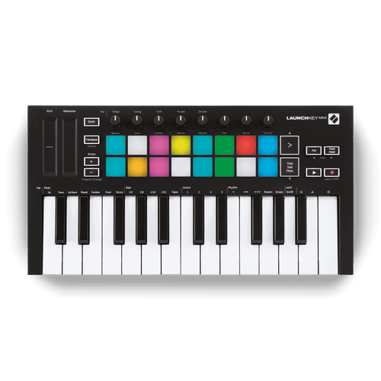
Midi with an external device
JUCE provides some useful midi_io classes
MidiInput class
MidiInputCallback class
MidiMessageCollector class, …
And in audio_io classes
AudioDeviceManager
But let the host handle external midi input

Slide 11
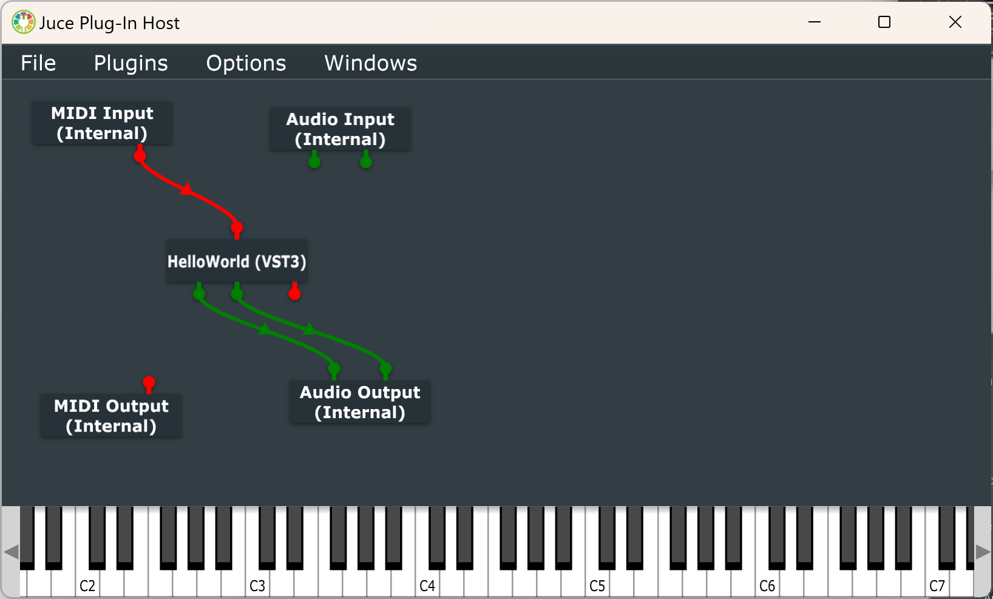
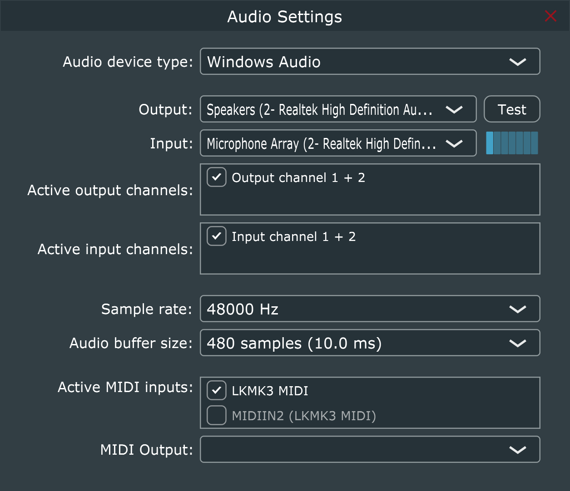
Midi with an external device
Build the plugin as VST3, not standalone
Connect a midi device (if you have one) to your computer
Load the plugin in JUCE’s plugin host
Open the midi input and select your device
Now play the keyboard ☺

